Slide 1
Tucker decomposition and Higher Order Singular Value Decomposition (HOSVD)
Salman Ahmadi-Asl
February 17, 2022

Slide 2
Outline
SVD and its main properties
Tucker decomposition and HOSVD
Algorithms for HOSVD
Truncated HOSVD (THOSVD)
Sequentially Truncated HOSVD (STHOSVD)
Higher Order Orthogonal Iteration (HOOI)

Slide 3
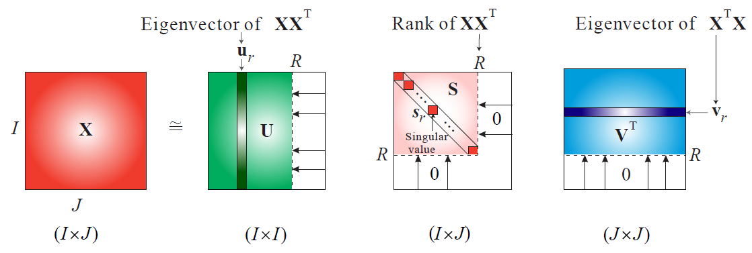
Singular Value Decomposition (SVD)

Slide 4
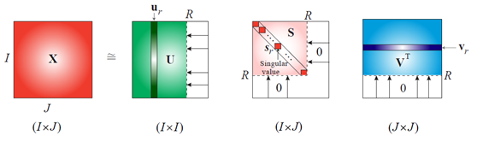

Singular Value Decomposition (SVD)
The middle matrix is always diagonal and nonnegative.
Truncated SVD always gives the best low-rank matrix approximation in the least-squares sense (in spectral and Frobenius norms)
C. Eckart, G. Young, The approximation of one matrix by another of lower rank. Psychometrika,
Volume 1, 1936, Pages 211–218.
Eckart-Young-Mirsky theorem

Slide 5
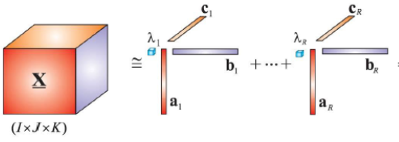
Singular Value Decomposition and its CPD generalization
Hitchcock's intuition
1927

Slide 6
Tucker Decomposition
Tucker's intuition
1963
But why?

Slide 7
Singular Value Decomposition (SVD) in terms of contraction operation

Slide 8
Singular Value Decomposition (SVD) in terms of contract operation

Slide 9
Singular Value Decomposition (SVD) in terms of contract operation
Order 3
Matrix
Order 4
Tensor

Slide 10
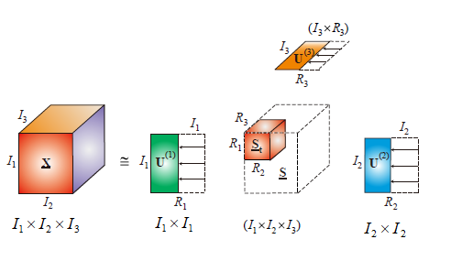
Singular Value Decomposition (SVD) in terms of contract operation
Diagonal and nonnegative
Will the core tensor be super-diagonal?
How about the factor matrices and their main properties?
Will the core tensor be nonnegative?
How to compute the factor matrices and the
core tensor?

Slide 11
Tucker decomposition and Higher Order SVD (HOSVD)
In the Tucker decomposition, there is no any constraints on the factor matrices or the core tensor while in the HOSVD, the factor matrices should be orthogonal and the core tensor is all-orthogonal and Pseudo-diagonal.
HOSVD is also called Multilinear SVD (MLSVD)
Lieven De Lathauwer, 2000

Slide 12

Compression ratio of the Tucker decomposition

Slide 13
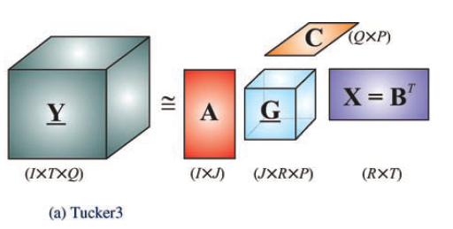
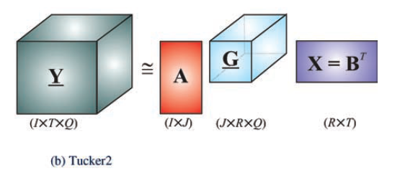
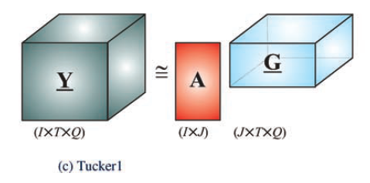
Different kinds of Tucker decomposition

Slide 14
Tucker decomposition and Higher Order SVD (HOSVD)

Slide 15
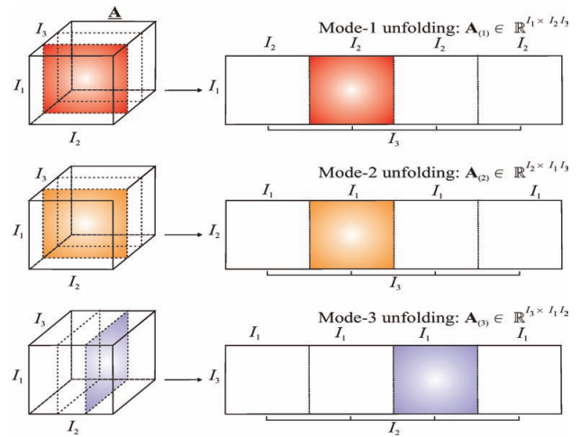
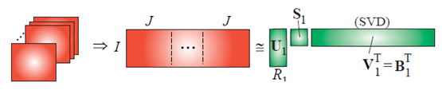
Truncated HOSVD (THOSVD)
Step 1. (Computation of the factor matrices) Unfolding a tensor along all its modes and computing the left singular values of the mentioned matrices.
Factor matrices
Tucker rank or multilinear rank

Slide 16
Truncated HOSVD (THOSVD)
It is much beneficial to compute left singular values through the eigenvalue decomposition of symmetric matrices

Slide 17
Truncated HOSVD (THOSVD)
Step 2. Computing the core tensor through contraction of the original data tensor with
the factor matrices computed
Why?

Slide 18
Truncated HOSVD (THOSVD)
If we have an exact model

Slide 19
Truncated HOSVD (THOSVD)
If we have an approximate model
For fixed factor matrices
the above formula provides the optimal core tensor in the
the least-squares sense

Slide 20
Truncated HOSVD (THOSVD)

Slide 21
Truncated HOSVD (THOSVD)
Please note that for matrices or second order tensors, we have
and
and
This is generally not true for tensors of higher order.

Slide 22
Truncated HOSVD (THOSVD) for matrices
and

Slide 23
Properties of THOSVD
Factor matrices are orthonormal
The core tensor is all-orthogonal and pseudo-diagonal.
All-orthogonality
Density in these directions are reduced.
Pseudo-diagonality

Slide 24
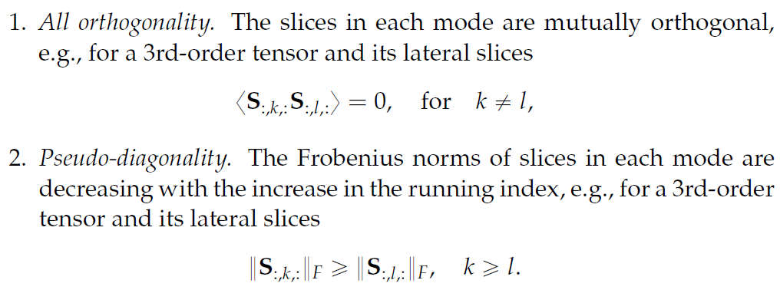
Properties of THOSVD

Slide 25
Truncated HOSVD (THOSVD)
mlsvd- (Truncated) multilinear singular value decomposition
mlsvds- Multilinear singular value decomposition for sparse tensors
tensorlab

Slide 26
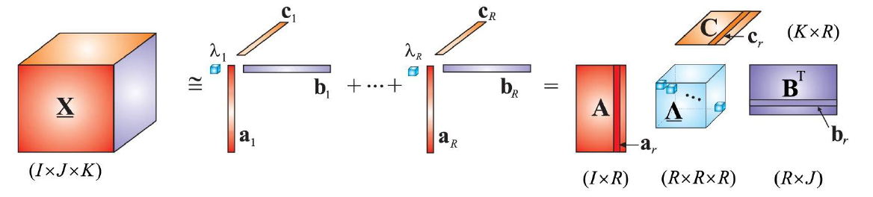
Connection between the CPD and the Tucker decomposition
The CPD is a special case of the Tucker decomposition

Slide 27
Sequentially Truncated HOSVD (THOSVD) for matrices
Sequentially Truncated HOSVD is a faster algorithm for computation of the HOSVD.
THOSVD
and

Slide 28
Sequentially Truncated HOSVD (THOSVD) for matrices
STHOSVD

Slide 29
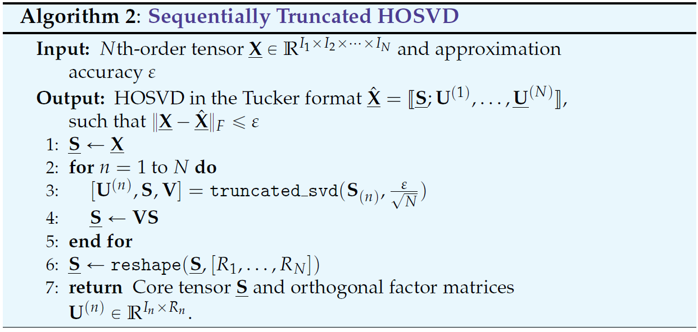
Sequentially Truncated HOSVD (STHOSVD)
Sequentially Truncated HOSVD (STHOSVD) is a faster algorithm for computing the best multilinear
rank approximation of a given tensors. Unlike the HOSVD where the unfolding matrices have the same
number of elements, at each iteration of the STHOSVD algorithm we are dealing with a
Smaller unfolding matrices.

Slide 30
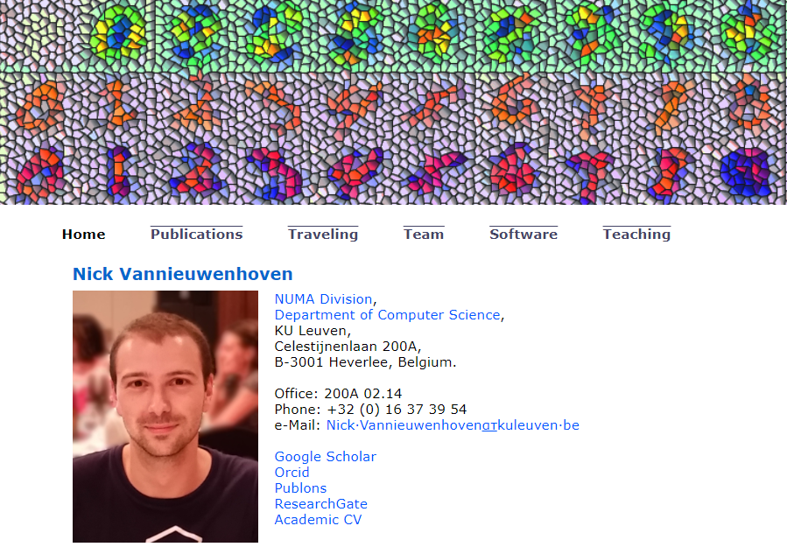
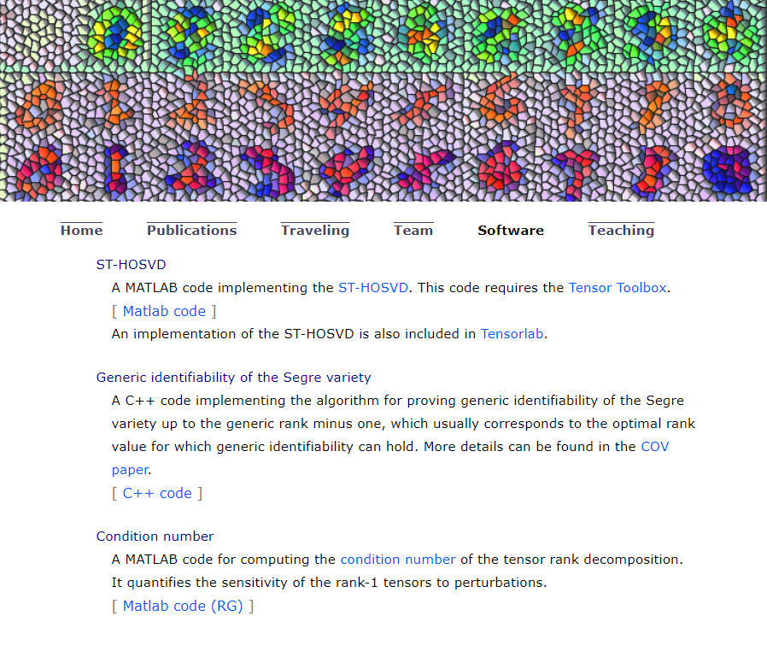
Sequentially Truncated HOSVD (STHOSVD)
mlsvd_rsi- Sequentially truncated MLSVD using randomized subspace
tensorlab

Slide 31
Best low Multilinear rank approximation
For a given multilinear rank
, the best multilinear rank approximation is defined as follows

Slide 32

Best low Multilinear rank approximation

Slide 33
Best low Multilinear rank approximation
!
THOSVD or STHOSVD do not give the best multilinear rank approximation of a given tensor and
they provide only suboptimal approximation.
!
How can we compute the best multilinear rank approximation?

Slide 34
Higher Order Orthogonal Iteration (HOOI)
Let
be orthonormal matrices then we have

Slide 35
Best low Multilinear rank approximation
This constrained optimization problem is nonconvex, so only convergence to local minima is guaranteed.
The Higher Order Orthogonal Iteration (HOOI) or Tucker-ALS is the simplest kind of algorithm for solving
the above constrained optimization problem.

Slide 36
Higher Order Orthogonal Iteration (HOOI)
In the HOOI or Tucker-ALS, at each iteration, we keep fixed all but one factor matrix and update the each factor
sequentially

Slide 37
Higher Order Orthogonal Iteration (HOOI)
The adjoint of the operator
Vector case

Slide 38
Higher Order Orthogonal Iteration (HOOI)

Slide 39
Higher Order Orthogonal Iteration (HOOI)

Slide 40
Higher Order Orthogonal Iteration (HOOI)

Slide 41
Higher Order Orthogonal Iteration (HOOI)
Independent of the core tensor
The ALS-type algorithm can be developed for this minimization problem.

Slide 42
Higher Order Orthogonal Iteration (HOOI)
Note the optimization problem is convex with respect to each factor matrix
but not with respect to all of them
Simultaneously, so there is no any guarantee to converge to global minima
and
leading eigenvalues and eigenvectors of

Slide 43
Higher Order Orthogonal Iteration (HOOI)

Slide 44
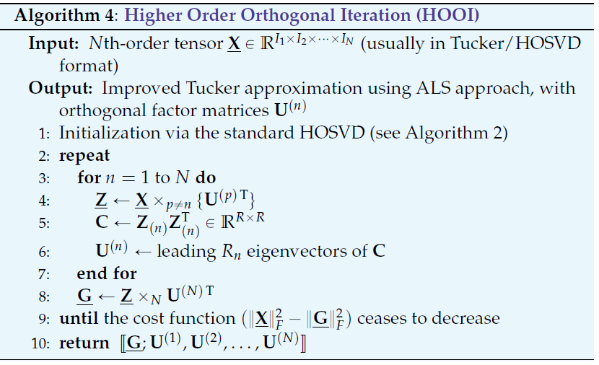
Higher Order Orthogonal Iteration (HOOI)
Higher Order Orthogonal Iteration is an iterative algorithm for computing the best multilinear rank
approximation of tensors. It is based on the idea of Alternating Least-Squares (ALS).
It is also known as Tucker-ALS algorithm.
tucker_als
in the tensor toolbox
lmlra_hooi
in the tensorlab toolbox

Slide 45
Applications of the Tucker decomposition
Tucker decomposition can be used in several applications including
Fast CPD computation
Data compression
Data denoising
Data completion

Slide 46
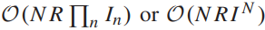
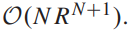


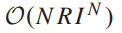
Faster CPD computation
The computationally cheapest algorithm for CPD of an order-N tensor, which employs the alternating least squares (ALS) updates, has a computational cost of assuming that the mode dimensions are equal and the estimated rank is .
Alternatives to a “direct” CPD computation have been proposed, such as a prior compression of the tensor using, e.g., the Tucker decomposition, which can reduce the computational cost of CPD to
if

Slide 47
CPD with a prior Tucker compression
Faster CPD computation
R. Bro, Multi-way Analysis in the Food Industry - Models, Algorithms, and Applications, Ph.D. thesis, University of Amsterdam, Holland, 1998.
CPD
HOSVD compression
Recovering the factor matrices
of the original tensor

Slide 48
Faster CPD computation
The CPD with a prior Tucker compression is only applicable when
the tensor rank does not exceed the tensor dimensions
the order of the tensor is not very high
otherwise, a prior Tensor Train (TT) decomposition should be used.
Curse of
dimensionality

Slide 49
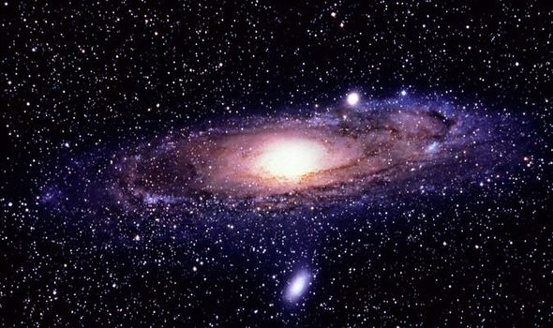

Higher order tensors
Consider a tensor of order 500 where the dimension of each mode is 2
!
Its number of components is larger than the estimated number of atoms in the universe.
!

Slide 50
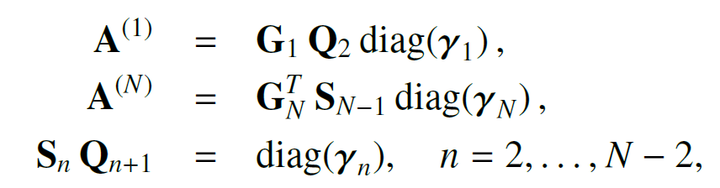
CPD with a prior TT compression

Slide 51
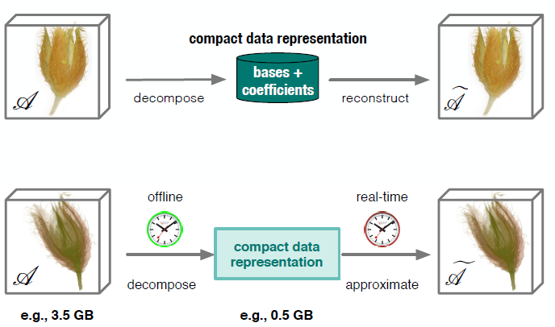
Data Compression and approximation
Compact representation of large scale data sets important in many areas of visual computing, scientific visualization and computer graphics
Use a mathematical framework for the decomposition of the input data into
bases and coefficients
Key features of a compact data representation:
‣ Feature adaptive decomposition
‣ Good data reduction
‣ Fast access and reconstruction
Tensor approximation methods have shown to be a powerful and promising alternative
R Ballester-Ripoll, Tensor methods for high-dimensional analysis and visualization, PhD Thesis.

Slide 52
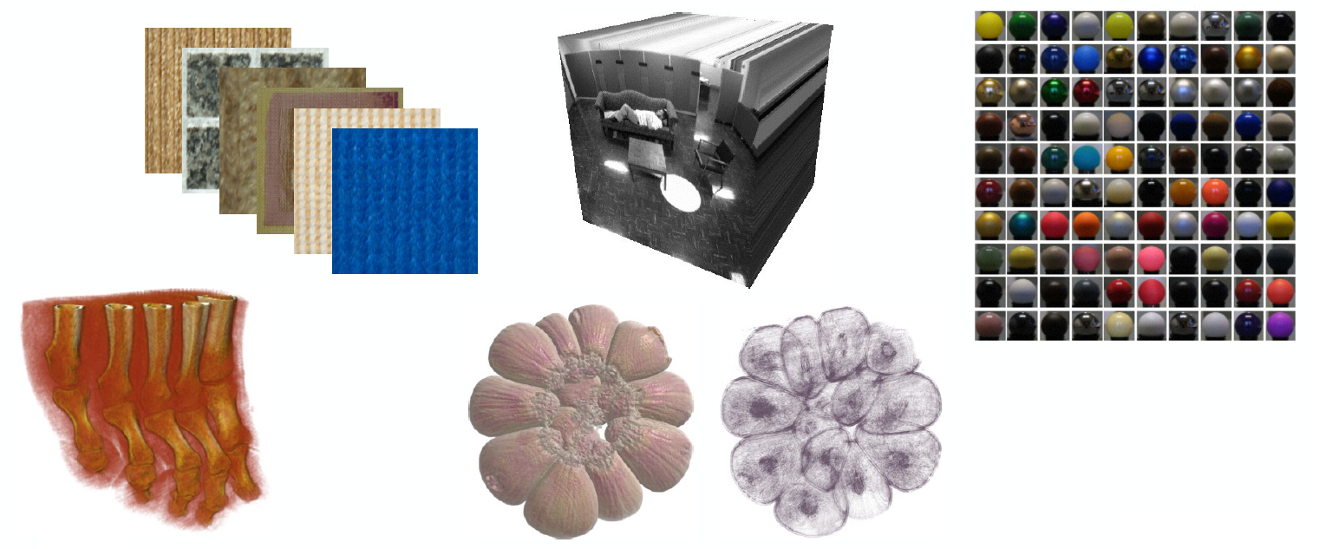
Multidimensional data tensors
R Ballester-Ripoll, Tensor methods for high-dimensional analysis and visualization, PhD Thesis.

Slide 53
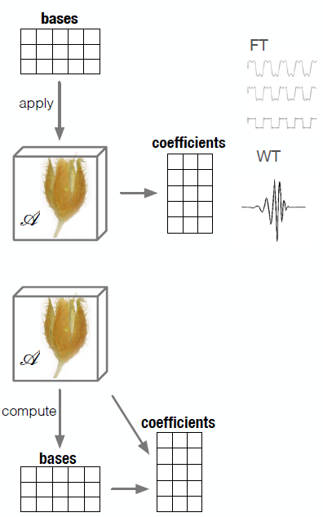
Data Compression and approximation
A fundamental concept of data decomposition is to analyze, extract and
preserve the most relevant data features and remove redundant and
irrelevant information
‣ E.g. through frequency analysis by projection onto pre-defined bases, or
extraction of data intrinsic principal components
– identify spatio-temporal and frequency redundancies
‣ Maintain strongest and most significant signal components
• Data reduction linked to concepts and techniques of data compression,
noise reduction as well as feature extraction and recognition/extraction
R Ballester-Ripoll, Tensor methods for high-dimensional analysis and visualization, PhD Thesis.

Slide 54
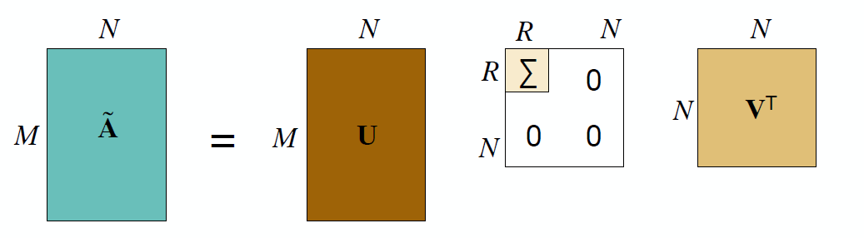
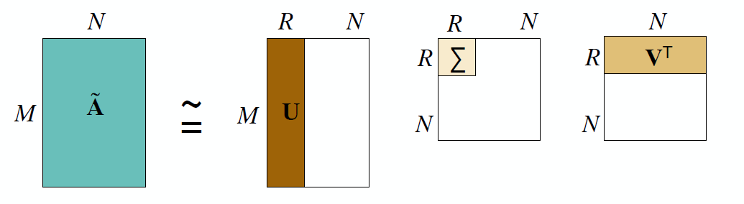
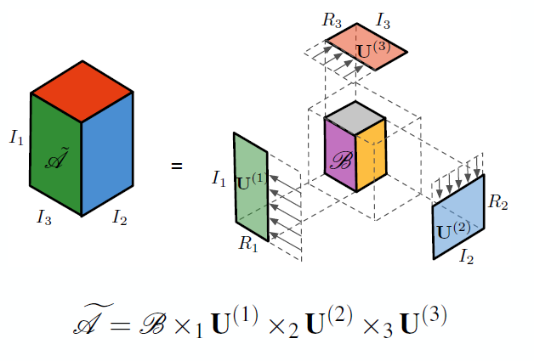
Data Compression and approximation
R Ballester-Ripoll, Tensor methods for high-dimensional analysis and visualization, PhD Thesis.

Slide 55
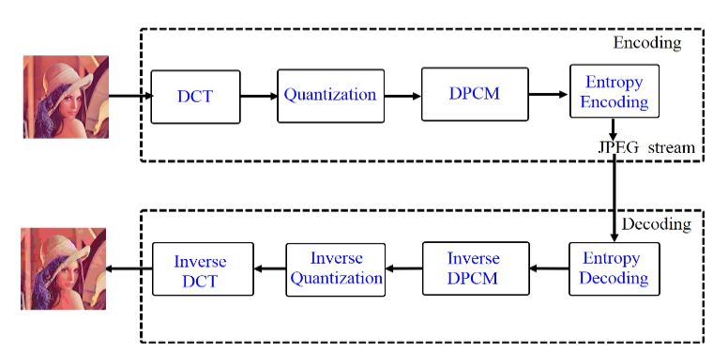
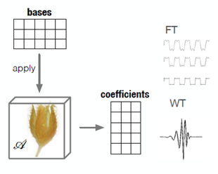
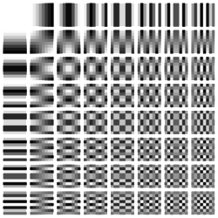
Data Compression and approximation
DCT

Slide 56
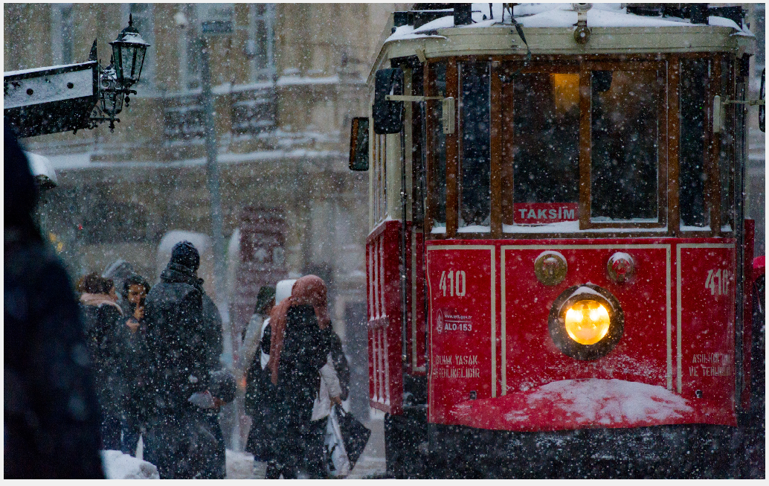



Data Compression and approximation
R
G
B

Slide 57
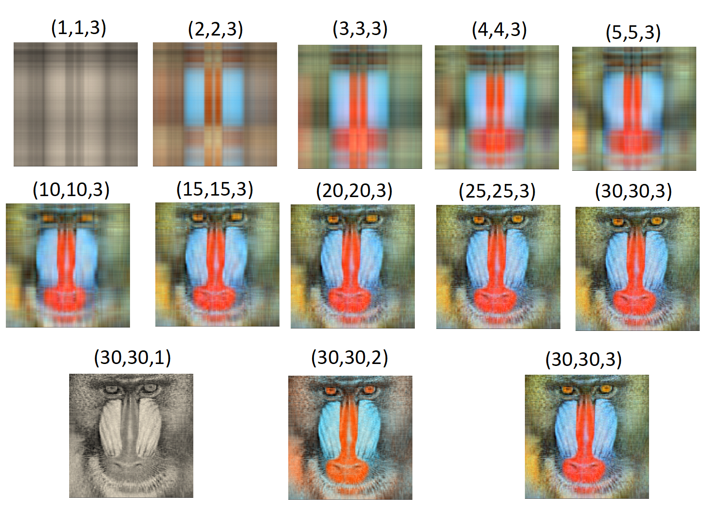
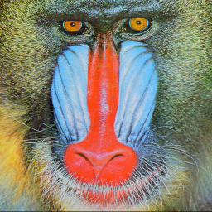
Application of Tucker model for compression
Original image
PSNR= 29.0222
SSIM=0.7104

Slide 58
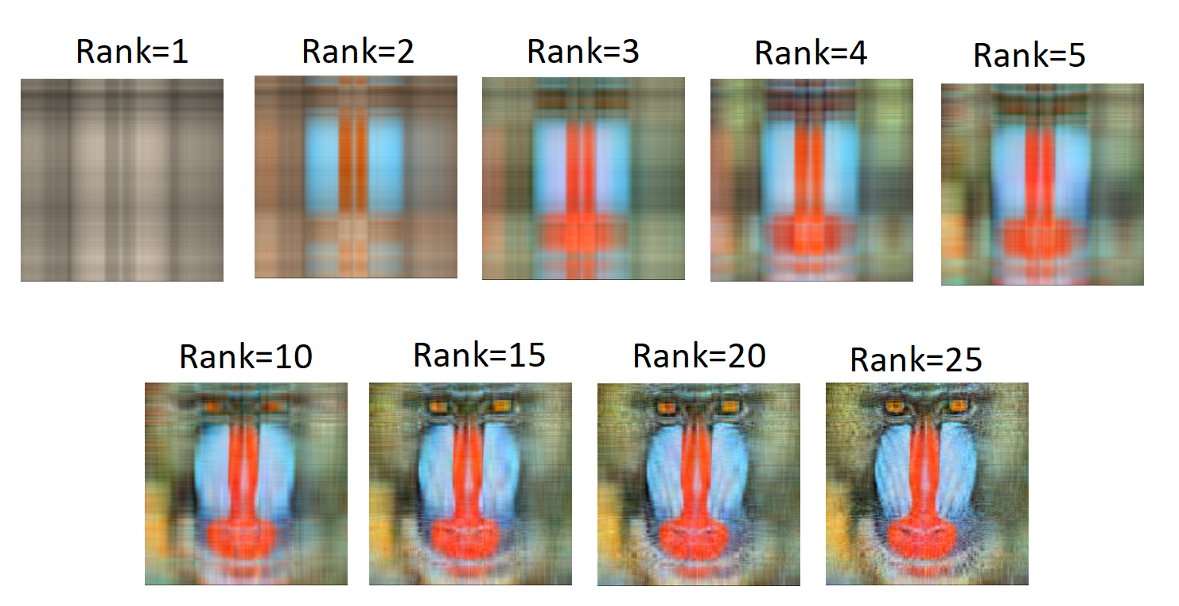
Application of Tucker model for compression
Original image
PSNR= 29.7992
SSIM=0.5330

Slide 59
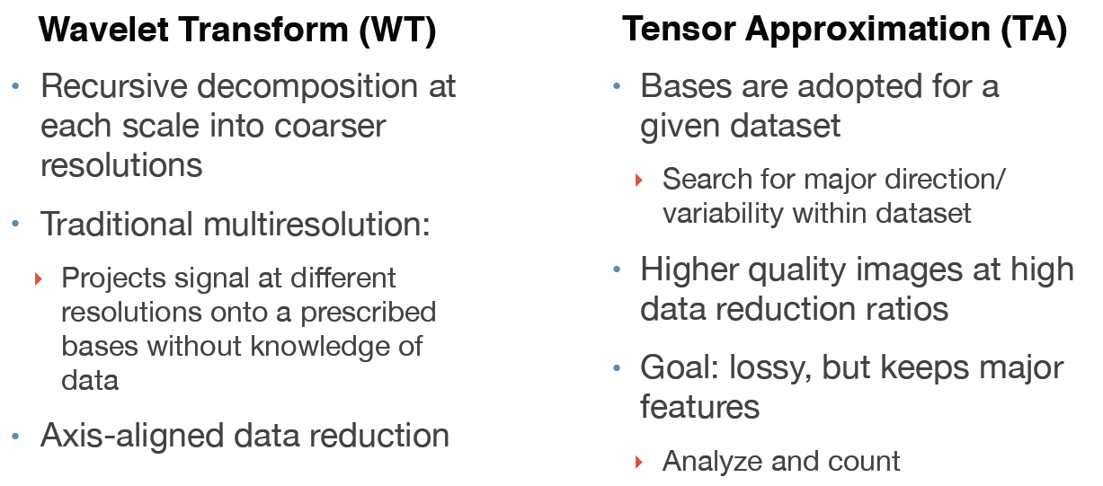
Data Compression and approximation
R Ballester-Ripoll, Tensor methods for high-dimensional analysis and visualization, PhD Thesis.

Slide 60
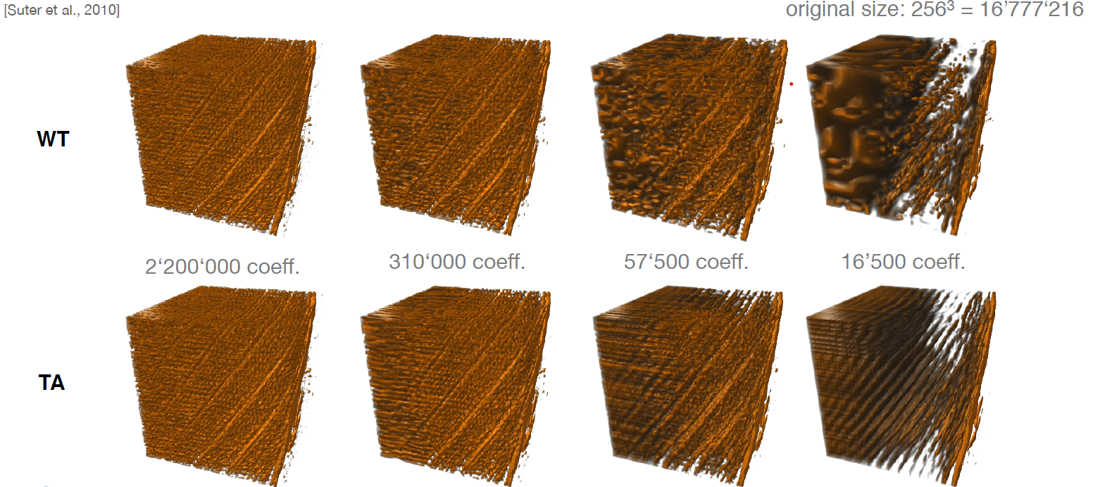
Data Compression and approximation
R Ballester-Ripoll, Tensor methods for high-dimensional analysis and visualization, PhD Thesis.

Slide 61
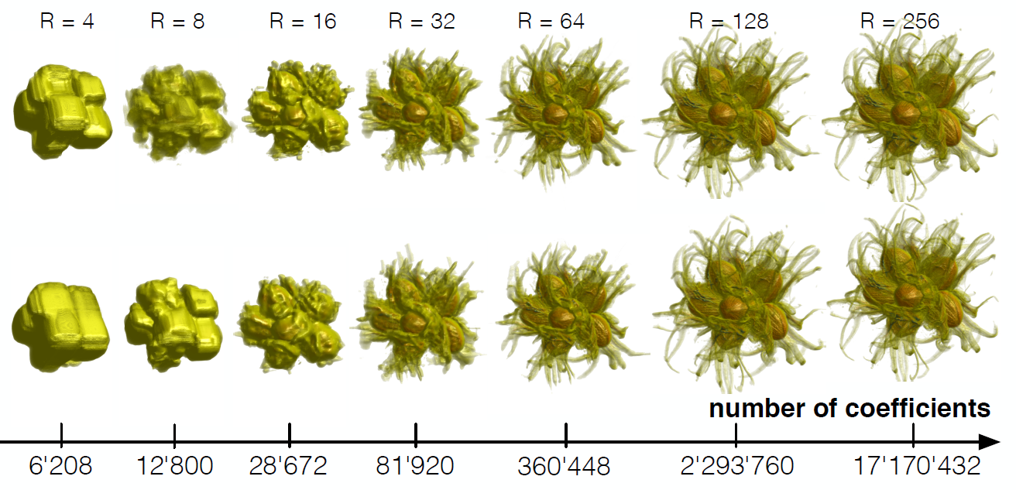
Data Compression and approximation
R Ballester-Ripoll, Tensor methods for high-dimensional analysis and visualization, PhD Thesis.

Slide 62
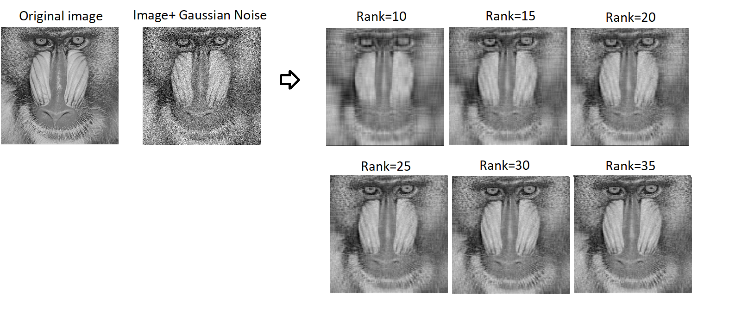
Tucker decomposition for data denoising
The real data usually contain a level of noise. In the case of matrices (2-order tensors),
the truncated SVD can be used to remove the noise from the data.
Here, the noise is treated as the tail of small singular value and we discard them.
PSNR= 29.0222
SSIM=0.7104

Slide 63
Tucker decomposition for data denoising
The same idea can be used for high order data tensors and the truncated version of them can be used
for removing the underlying noises.
Tucker decomposition
Tensor Train Decomposition
Block Tensor Decomposition
CP decomposition

Slide 64
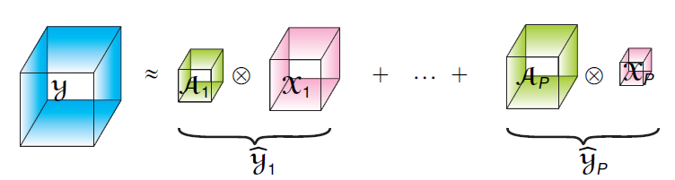
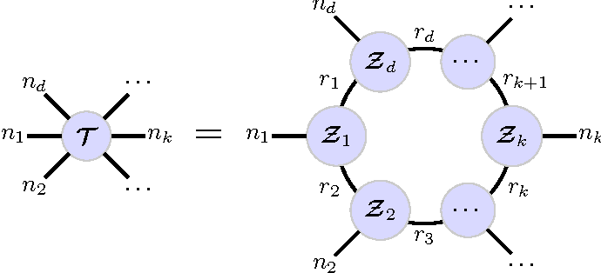
Tucker decomposition for data denoising
Kronecker Tensor Decomposition (KTD)
Tensor Ring Decomposition
Tubal Tensor Decomposition

Slide 65
Tensor/Matrix completion
• Matrix completion is the problem of estimating missed or uncertain elements of a matrix using its available elements.
• Image (black and white) completion
• Time series completion
• Recommender system
• …

Slide 66
Tensor/Matrix completion
• A Famous example
•Netflix:
•The matrix contains highly incomplete rating of
0.5 million users for 17770 movies
•How rating of unseen movies can be estimated

Slide 67
Tensor/Matrix completion
• Generally the problem is ill-posed
• The system is underdetermined
• Number of observations is less than
the number unknowns

Slide 68
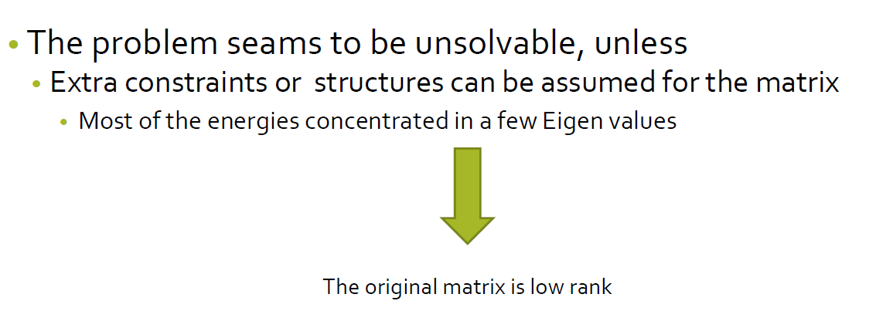
Tensor/Matrix completion

Slide 69
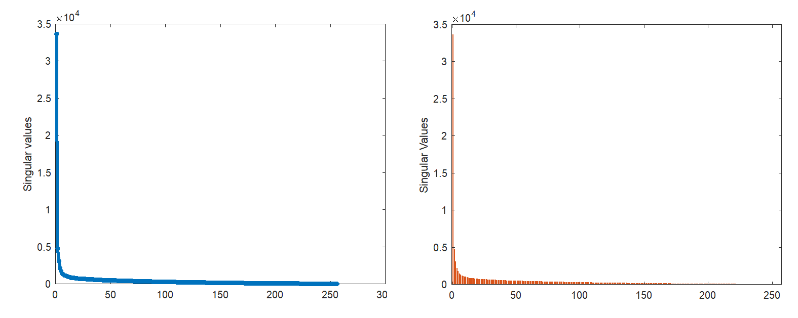
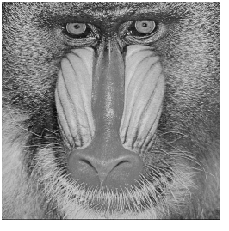
Singular Value Decomposition (SVD)
256 x256

Slide 70
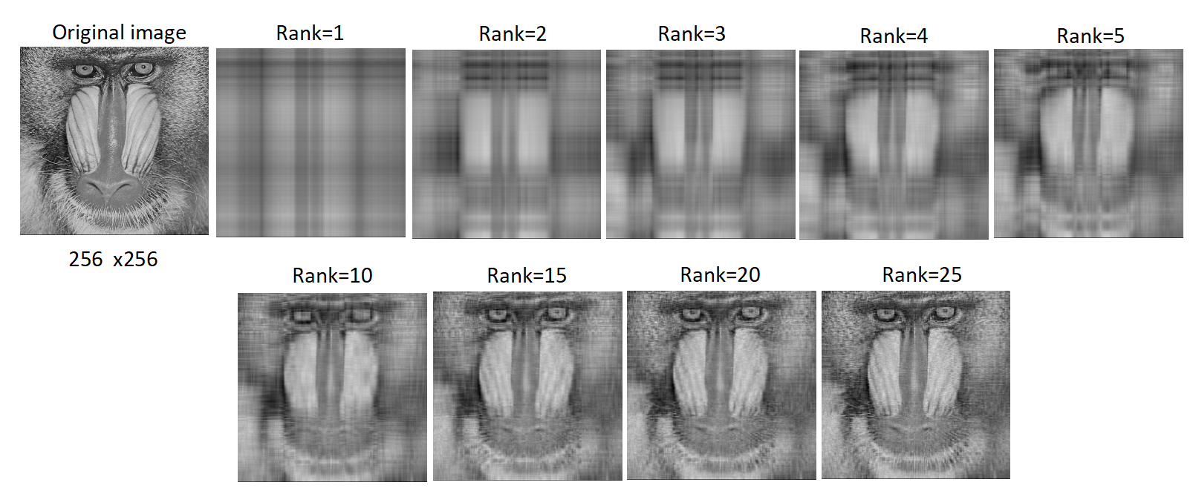
Singular Value Decomposition (SVD)
PSNR= 30.3660
SSIM=0.6004

Slide 71
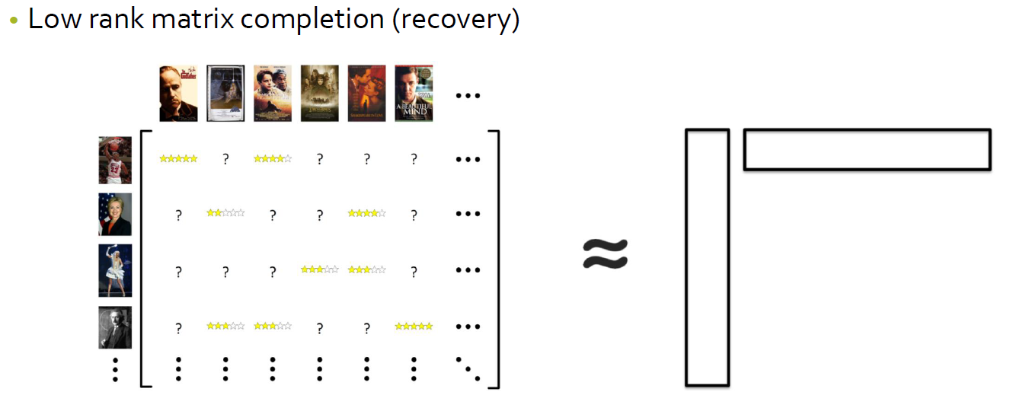
Tensor/Matrix completion

Slide 72
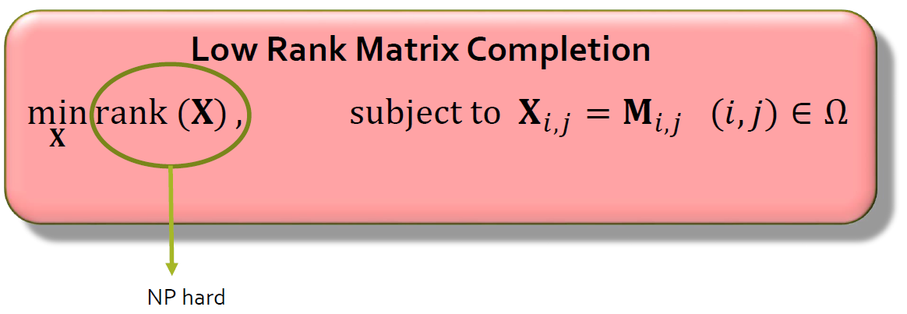
Tensor/Matrix completion

Slide 73
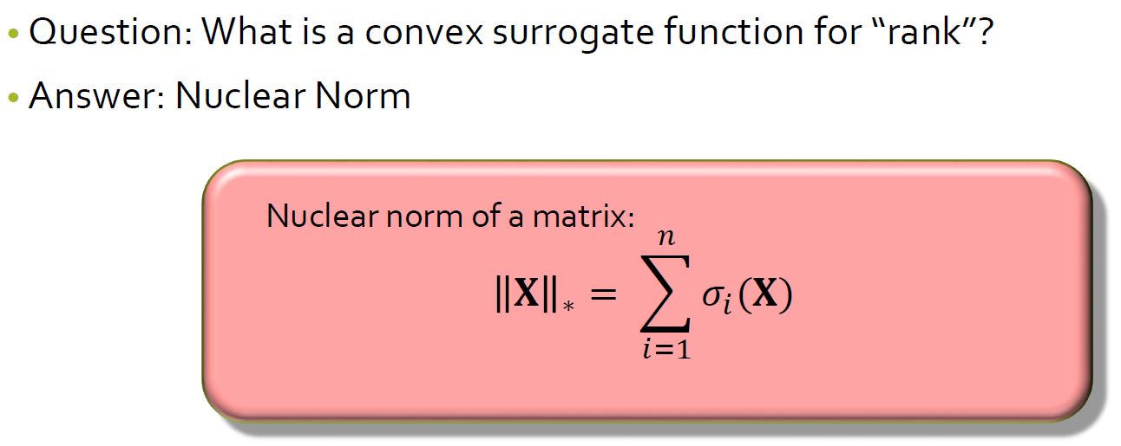
Tensor/Matrix completion

Slide 74
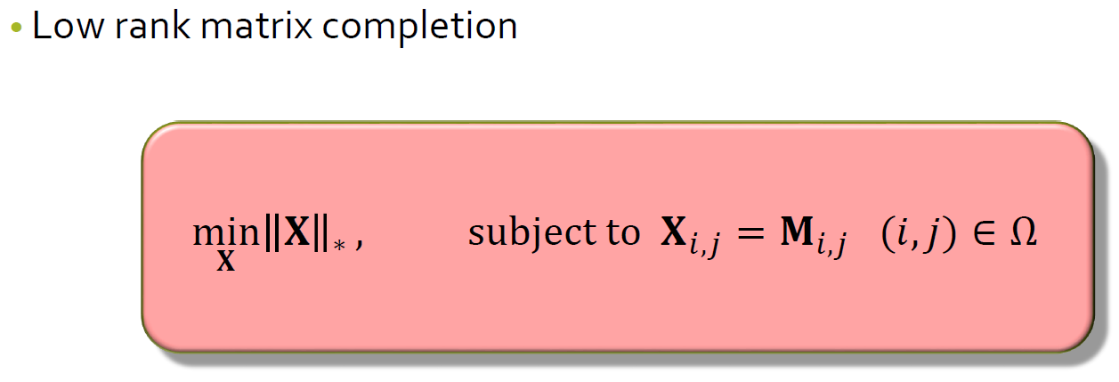
Tensor/Matrix completion

Slide 75
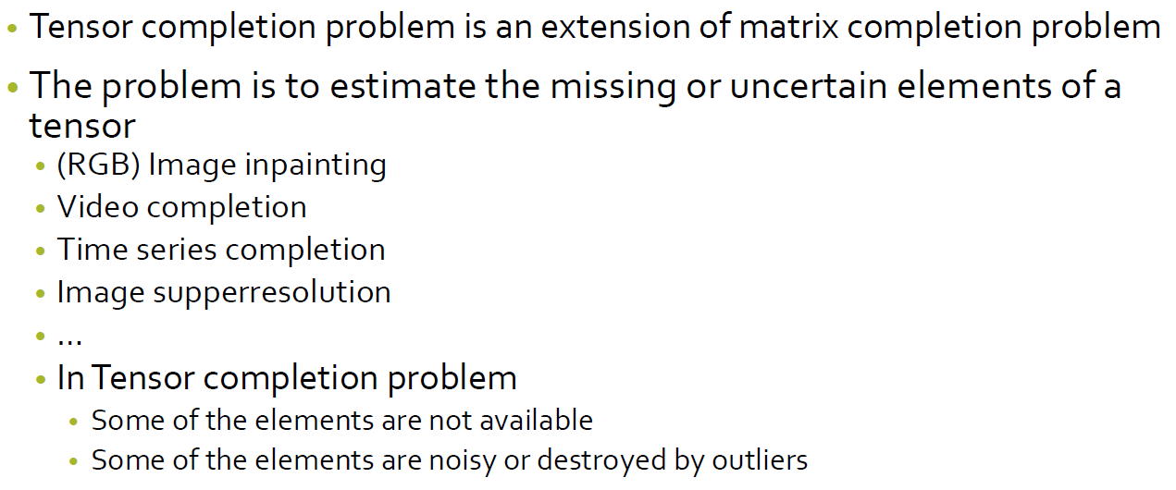
Tensor/Matrix completion

Slide 76
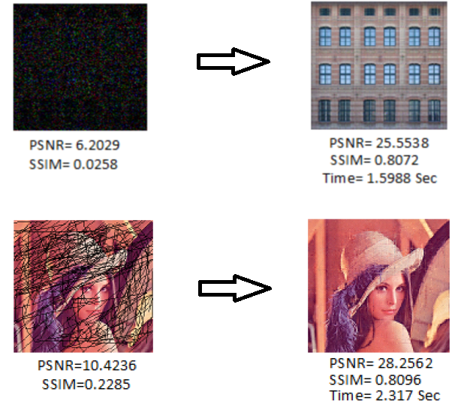
Tensor/Matrix completion
Video completion
Image completion (inpainting)

Slide 77
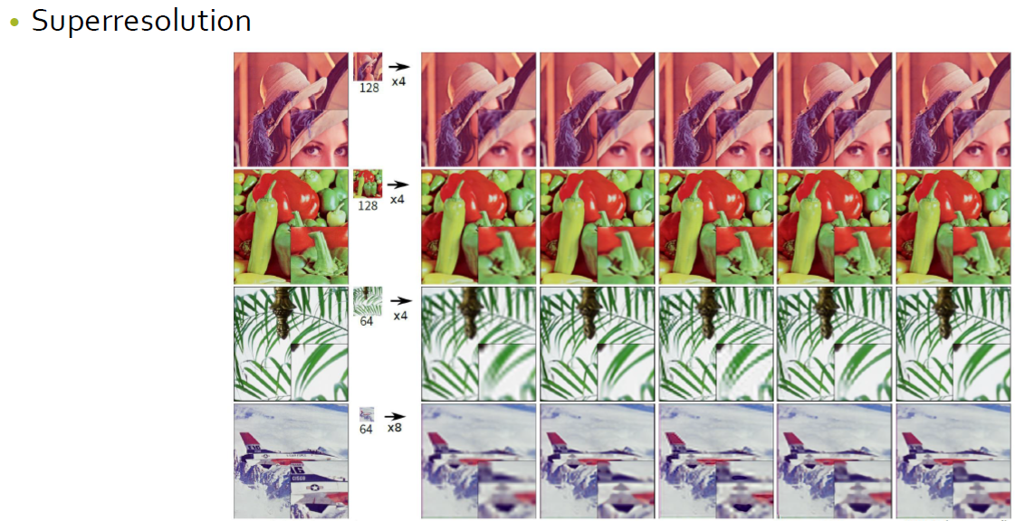
Tensor/Matrix completion

Slide 78

Two main categorizes for tensor completion

Slide 79

Rank minimization approach

Slide 80

Rank minimization approach

Slide 81

Rank minimization approach

Slide 82

Rank minimization approach

Slide 83

Rank minimization approach

Slide 84

Rank minimization approach

Slide 85

Rank minimization approach

Slide 86

Rank minimization approach

Slide 87

Rank minimization approach

Slide 88

Rank minimization approach

Slide 89


Rank minimization approach

Slide 90

Tensor decomposition approaches

Slide 91

Tensor decomposition approaches

Slide 92

Tensor decomposition approaches

Slide 93

Tensor decomposition approaches

Slide 94

Tensor decomposition approaches

Slide 95

Tensor decomposition approaches

Slide 96

Tensor decomposition approaches

Slide 97
Any questions?

